Slide 1

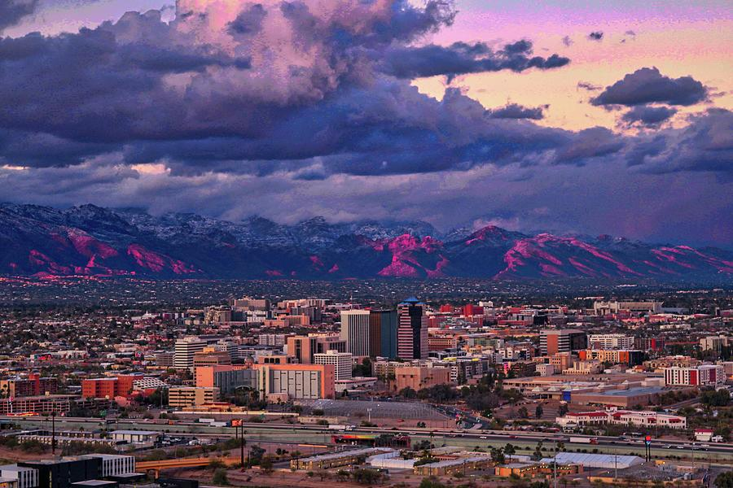
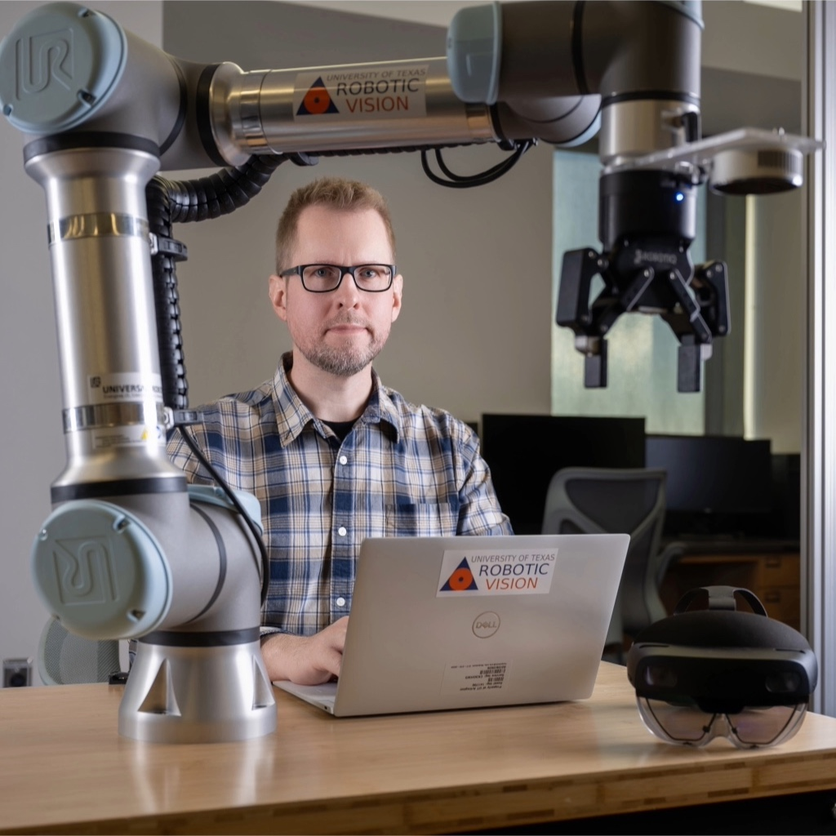
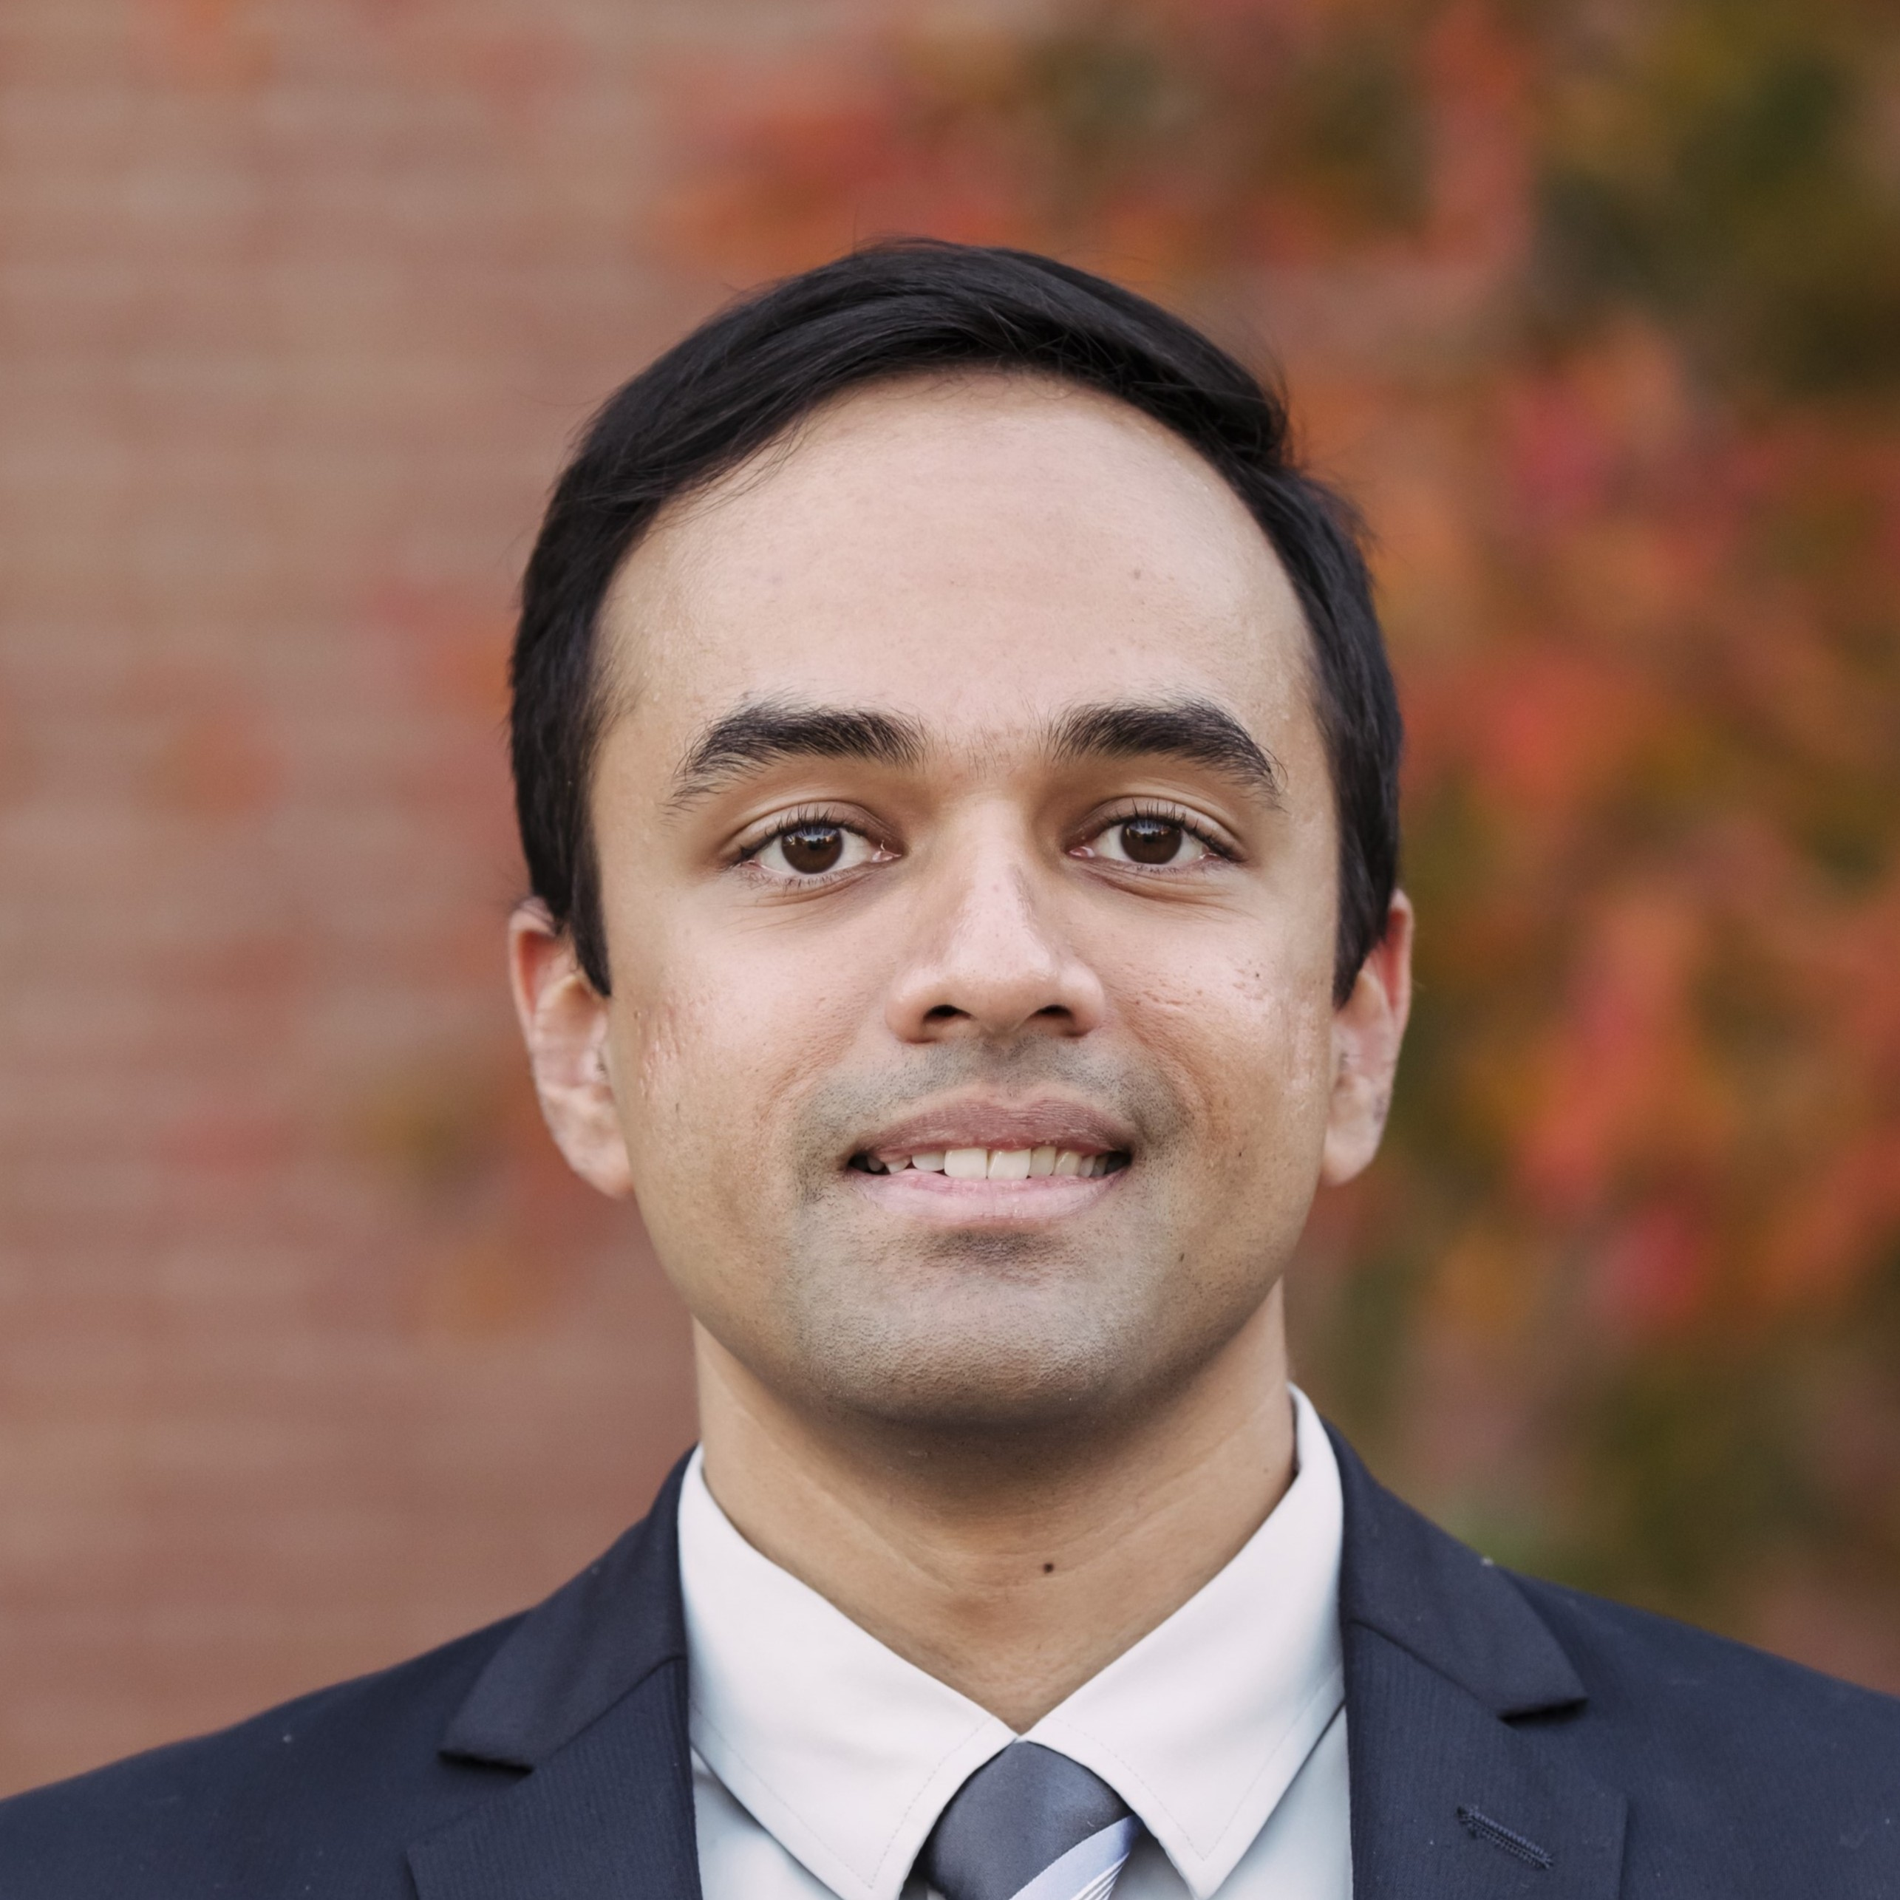
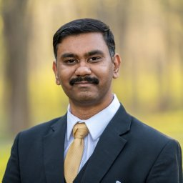
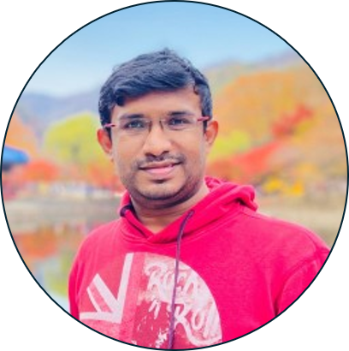
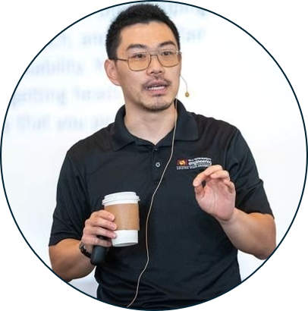
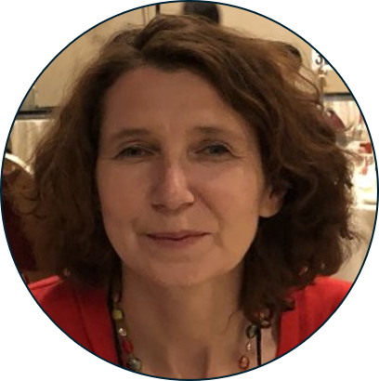
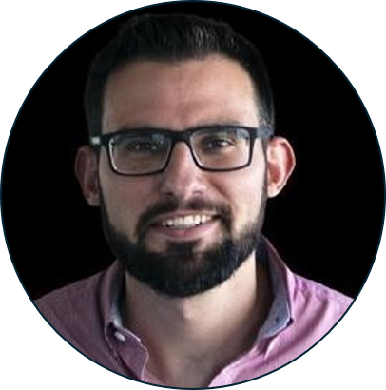
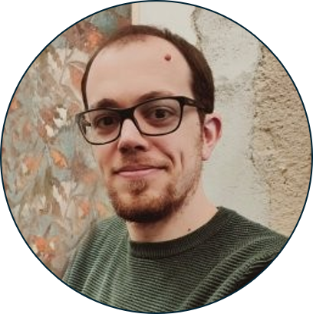
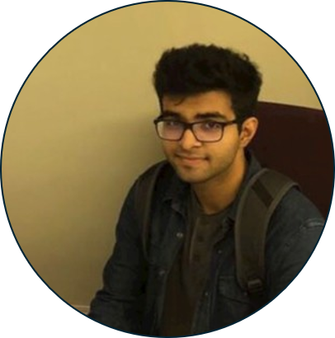
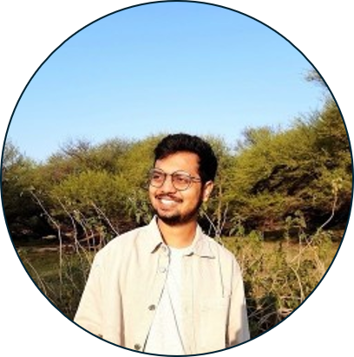
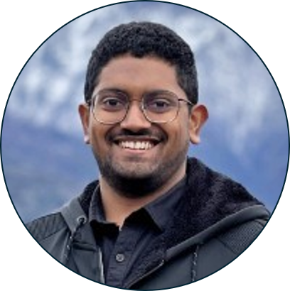

EVGEN 2026: The 2nd Workshop on
“Event-based Vision in the Era of Generative AI”: Transforming Perception and Visual Innovation
Speakers
William Beksi
University of Texas at Arlington
Tejas Gokhale
University of Maryland, Baltimore County
Nitin Sanket
Worcester Polytechnic Institute
Organizers
Bharatesh
Chakravarthi
Yezhou
Yang
Cornelia M. Fermuller
Francisco Barranco
Federico Becattini
Aayush Atul Verma
Arpit Vaghela
Kaustav Chanda
Time: March 6, 1 PM – 5:30 PM
Location: Arizona Ballroom 7

